Slide 1



E-BANKING System
Dr. May Dehayni
Rana Jaafar - 97456
Fatima Baher - 98683
Mohammad Darsa - 97757
Mohammad Makkeh - 99243
Course: INFO 404 Advanced object oriented programming
LEBANESE UNIVERSITY
Faculty of Science
2023

Slide 2
INTRODUCTION
The digital wallet is a digital version of a traditional or physical wallet, Users can use a digital wallet to store money and spend it later.
The digital wallet stores all payment information of users in a secure and compact mode.
digital wallets are financial application that allow users to make transactions and track payment histories for different payment modes.

Slide 3
The project is made simple and clear in order to cover all the learn topic in this course ( INFO 404 Advanced object oriented programming ))

Slide 4
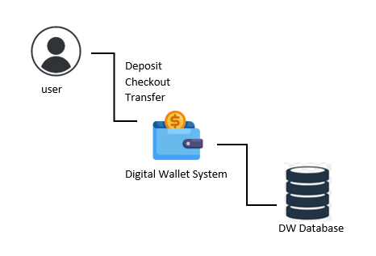
Requirements Analysis
Functional Requirements
The guest can sign up
The guest can log in with his username and password
After logging in ,the user can access to his pages, use the services and log out
The system must support multiple currencies(USD,LBP,..)
The user can view his transaction histories and the total balance in his wallet
The user can transfer money to somebody else’s wallet on the same system
The user can add a card that is connect to a bank account

Slide 5
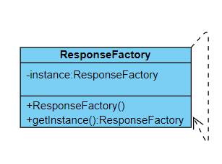
Design Pattern
Singleton DP
We Used Singleton DP with a Lazy initialization to create the instance once needed
only one object exists at runtime
public class ResponseFactory { private static ResponseFactory instance;
private ResponseFactory(){}
public static ResponseFactory getInstance(){
if(instance==null)
instance=new ResponseFactory(); return instance; }
--------
}

Slide 6
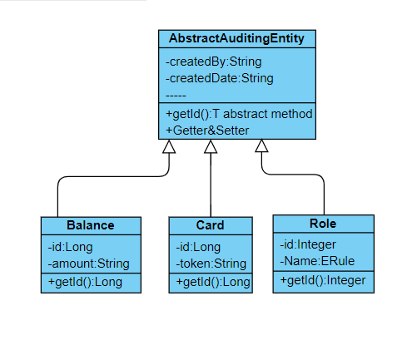
Design Pattern
Template DP
We Used Template DP to create a template for algorithm Also the abstract class exposes defined way(s)/template(s) to execute its methods algorithm .
@MappedSuperclass @EntityListeners(AuditingEntityListener.class) @JsonIgnoreProperties(value = { "createdBy" , "createdDate", "lastModifiedBy", "lastModifiedDate" }, allowGetters = true) public abstract class AbstractAuditingEntity<T> implements Serializable { private static final long serialVersionUID = 1L; public abstract T getId(); @CreatedBy @Column(name = "created_by", nullable = false, length = 50, updatable = false) private String createdBy; @CreatedDate @Column(name = "created_date", updatable = false) private Instant createdDate = Instant.now();

Slide 7
Design Pattern
Template DP
@Entity @Table(name = "balance") @SuppressWarnings("common-java:DuplicatedBlocks") public class Balance extends AbstractAuditingEntity<Long> implements Serializable { private static final long serialVersionUID = 1L; @Id @GeneratedValue(strategy = GenerationType.AUTO) @Column(name = "id") private Long id;
public Long getId(){
return this.id;
}
-----
}
@Entity @Table(name = "card") @SuppressWarnings("common-java:DuplicatedBlocks") public class Card extends AbstractAuditingEntity<Long> implements Serializable { private static final long serialVersionUID = 1L; @Id @GeneratedValue(strategy = GenerationType.AUTO) @Column(name = "id") private Long id;
------ public Long getId() { return this.id; }
----
}

Slide 8
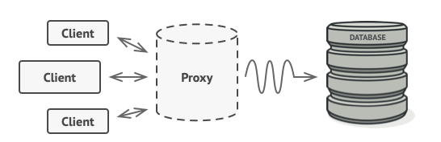
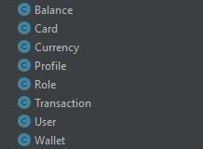
Design Pattern
Proxy DP
Proxy means ‘in place of’, representing’ or ‘in place of’ or ‘on behalf of’ are literal meanings of proxy and that directly explains Proxy Design Pattern.
“Controls and manage access to the object they are protecting“.
Example 1:
The proxy disguises itself as a database object.

Slide 9
Design Pattern
Proxy DP
The main advantage is the security of the original object.
Example 2:
One of the best matching examples for the Proxy pattern is the Bank account and the Credit card. The bank account is the real object and it represents by the Credit card. Therefore Credit card is a proxy for the bank account.
public class CardDTO implements Serializable { private Long id; private String token; private String maskedPan; private LocalDate expiry; private String displayName; private Boolean expired; private WalletDTO wallet;
------
}
A credit card is a proxy for a bank account
@Data @AllArgsConstructor @NoArgsConstructor public class CardDto { private Long id; private String pan; private String cvv; private LocalDate exDate; private String currency; private Double amount;
-------- }

Slide 10
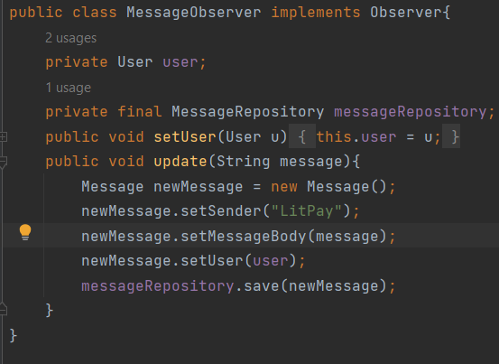
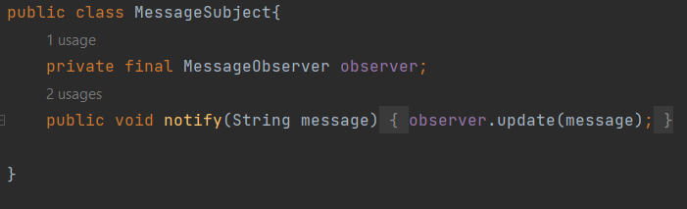
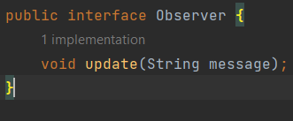
Design Pattern
Observer
The main advantage is the security of the original object.
Example:
The Observer observes when the balance of a user is below a certain threshold and creates a message to notify the user. An example is shown below:

Slide 11
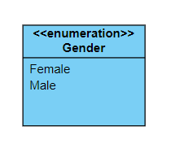
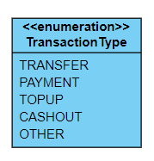
Enumeration
Enumerations serve the purpose of representing a group of named constants in a programming language.
Has specific constant instances, no other new objects.
Example 1:
public enum Gender { MALE, FEMALE, }
Example 2:
public enum TransactionType { TRANSFER, PAYMENT, TOPUP, CASHOUT, OTHER, }

Slide 12
ToString
toString() method in Java is used to write a string to the Console
@Override public String toString() { return getClass().getName()+"{" + "id=" + getId() + ", amount=" + getAmount() + ", currency=" + getCurrency() + ", wallet=" + getWallet() + "}"; }
@Override public String toString() { return getClass().getName()+"{" + "id=" + getId() + ", token='" + getToken() + "'" + ", maskedPan='" + getMaskedPan() + "'" + ", expiry='" + getExpiry() + "'" + ", displayName='" + getDisplayName() + "'" + ", expired='" + getExpired() + "'" + ", wallet=" + getWallet() + "}"; }
The balanceDto in log.debug call the method toString() in BalanceDto Class
@Override public String toString() { return "WalletDTO{" + "id=" + getId() + ", referenceId='" + getReferenceId() + "'" + ", user=" + getUser() + "}"; }
@Override public BalanceDTO update(BalanceDTO balanceDTO) { log.debug("Request to update Balance : {}", balanceDTO);
----
}

Slide 13
Generic type
@Data @Accessors(chain = true) public class BaseResponse<T> { private String status; private String code; private String message; private T response; }
Generic Class with generic instance variable
@Component public class ResponseFactory { ----
public <T> BaseResponse<T> success(T response) { return new BaseResponse<T>().setResponse(response).setCode("0").setMessage("Success").setStatus("SUCCESS"); } public BaseResponse fail(String status, String code, String message) { return new BaseResponse().setStatus(status).setCode(code).setMessage(message); }
}
Success is generic method

Slide 14
Generic type
public abstract class AbstractAuditingEntity<T> implements Serializable { private static final long serialVersionUID = 1L; public abstract T getId();
Genercic Class with generic method (getId())
public class Balance extends AbstractAuditingEntity<Long> implements Serializable { private static final long serialVersionUID = 1L; @Id @GeneratedValue(strategy = GenerationType.AUTO) @Column(name = "id") private Long id; -----
public Long getId() { return this.id; }
-----
}

Slide 15
Equals
equals() Method in Java compares 2 objects for equality;
//1. explicit param otherObject @Override public boolean equals(Object otherObject){ //2.a quick test to see if the objsare identical if (this == otherObject) return true; // 3.must return false if the explicit paramis null if (otherObject== null) return false; // 4.if the classes don't match, they can't be equal: reflection meth. getClass() if (getClass() != otherObject.getClass()) return false; CardDto var = (CardDto) otherObject; //5.test whether the fields have identical values // 2 Cards are equal if they have same pan, cvv, exp return Objects.equals(cvv, var.cvv) && Objects.equals(pan, var.pan) && Objects.equals(exDate, var.exDate); }
We used Lambda expression and we call equals() inside filter to keep only the cards that have specific conditions
cards.stream() .filter(card -> {CardDto.toDto(card,cb); return ca.equals(cb); }) .map(c -> new CardDto(c.getId(), c.getPan(), c.getCvv(), c.getEx_date(), c.getCurrency(), c.getAmount())) .findFirst().orElse(new CardDto());

Slide 16

Merci pour votre attention

